Slide 1
Compliant Database DevOps
Deliver Value Quicker While Keeping Your Data Safe
Christopher Unwin, Data Protection Specialist, Redgate Software
Moderated By: [MODERATOR]
Notes:
[Moderator Part]
The moderator’s script will be added in this section after deck submission.

Slide 3


Christopher Unwin
Ex-MIS Developer & ERP Analyst
Worked on Financial System implementation, configuration and management for PA Consulting Group and SIG plc
Blogger on Data Anonymization
Data Protection Specialist,
Redgate Software
Articles include “The right to be forgotten and Data Masking” and “Approaches to masking E-mail Addresses”
Co-Host Redgate ‘DBAle’ Podcast
/christopherunwincambridge
Podcast on Database Development and Data Protection available on iTunes, Google Play and Spotify
@RedG_Chris
Chris.unwin@red-gate.com
Notes:
[Moderator Part]
The moderator’s script will be added in this section after deck submission.

Slide 4
Agenda
Introductions
The current state of Database DevOps
Evolving the model to include Data Compliance through Provisioning and Monitoring
Redgate Demonstration
Notes:
Thank you very much for that introduction [moderator name] and thank you everyone for joining us today.
As was stated there we’re going to be talking a bit more about Compliant DevOps for the Database. But what does Compliant Database DevOps actually MEAN? Well fortunately I’m here to break this down for you and explain a little more about what we do at Redgate and what sort of problems we talk about and tackle on a daily basis.

Slide 5
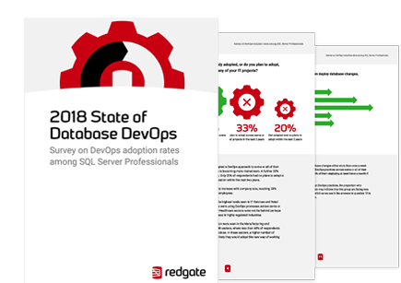
The State of Database DevOps
Notes:
We all know that DevOps is the unification of People, Processes and Tooling; all coming together in harmony to provide true innovation to our clients and end-users. But that’s just the easy way of putting it.
Implementing a true DevOps process is something that can take days, weeks and months of change in any or all of these areas and this means that everyone who wishes to implement this ‘way of life’ for database development will find themselves some way along this path.
This is something that the Redgate 2018 State of Database DevOps Report aimed to try and measure, to get some indicative numbers for how much people have been able to implement on their own journey. Over 700 organizations were asked whether they had adopted, or were planning to adopt, DevOps practices and how many of them had applied the same principles to their databases. The report looks at how things have developed over the last 12 months, and what key challenges and requirements are driving DevOps adoption in 2018.
So a quick question for you all first before we have a sneaky peek at some of the results:
***POLL: Which (if any) of these practices are already in place for your database development?***

Slide 6
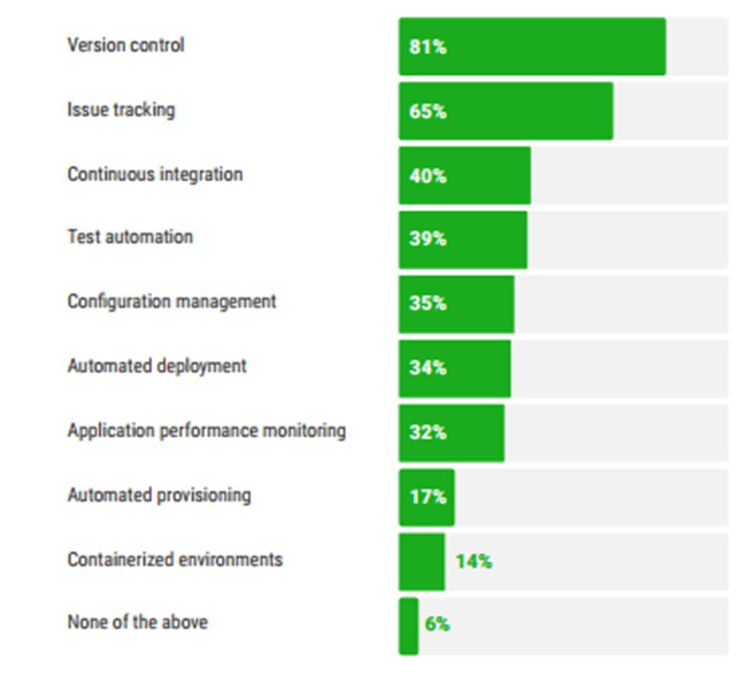

Where are we now?
Which, if any, of these practices are already in place for your Application development?
Which, if any, of these practices are already in place for your Database development?
Notes:
Well, where are we now? We it’s clear to see that there is still a wide gap between what is seen as a standard for Application development and Database development. I’d be keen to have a chat with the 19% who weren’t version controlling app development, just out of sheer curiosity!
But these sorts of repeatable, reliable, flexible processes are key to ensuring you know what is happening on your data estate at any given time, what changes people are making and crucially where any risk lies.
For them to be so far down the adoption list still means that we still have a long way to go or at least that something is preventing us from adopting DevOps.

Slide 7
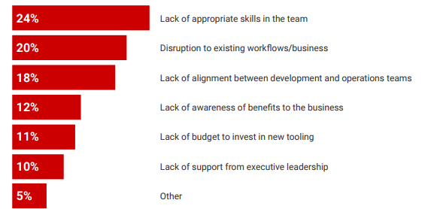

What is preventing organizations from implementing Database DevOps?
Notes:
This is where that initial definition that we got from Donovan Brown really speaks true volume – everything noted here as a blocker to DevOps adoption is an inherent issue in one of the People, Processes or Tools components of the model that needs to be in harmony for DevOps adoption to be successful.
The most interesting one there in my view is the “Lack of awareness of benefits to the business” – given that DevOps allows us to deliver innovation quickly up our development pipeline and allow our customers and end users to see value sooner, you would think it’s more immediately obvious, but again this is all about communication.
So we go ahead and implement DevOps practices for the Database, everyone is on board, but what does it actually look like.

Slide 8
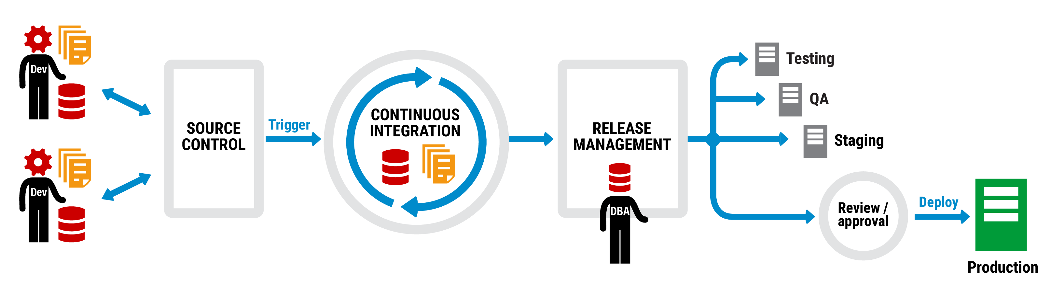
What does Database DevOps look like?
Notes:
CU [briefly describe exactly what is going on in the DB DevOps process]
But there’s something missing from this diagram, the key to our success when we talk about Databases and Database DevOps… the data!

Slide 9
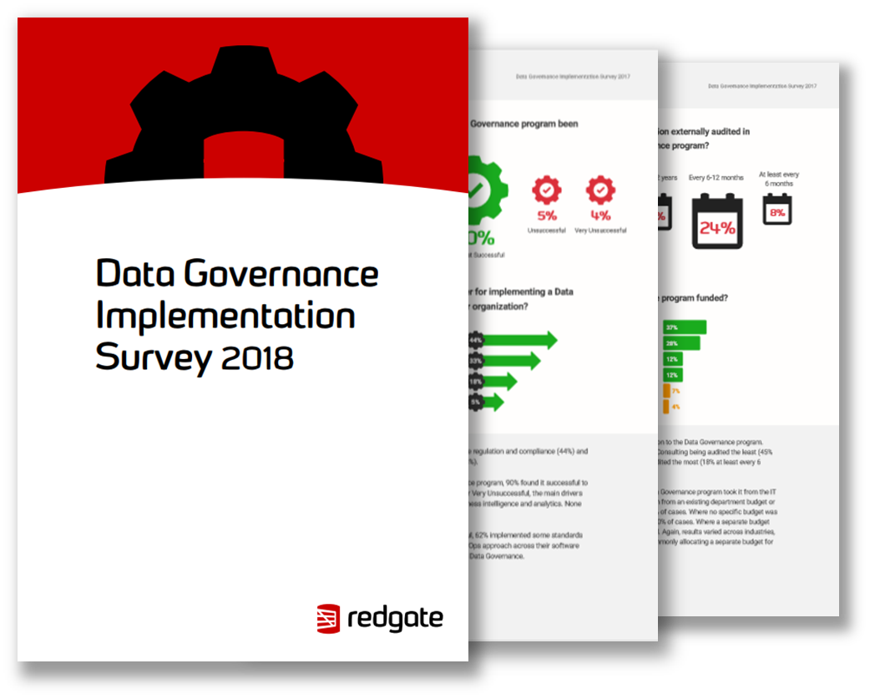
Data Governance Implementation
Notes:
Data Compliance and Compliance in general will continue to drive data governance from a technology issue onto board agendas. Drivers for this change include legislation like HIPAA in the Health sector, the EU’s GDPR, and many other inevitable new data regulations around the world, that are yet to come.
Now Redgate also ran a Data Governance Implementation Survey and in this report over 500 SQL Server professionals responded and gave us an indication of how they handle the technical and business challenges of Data Governance in their organisations which gives us some insight as to how people handle data as part of some of the aforementioned processes we’ve been through today.
I think this is probably a good time to ask you good people a couple of questions so we can get a feel for your own data challenges!
***POLL: Which (if any) of these regulations does/will your organization need to comply with?***
***POLL: Where do you record databases/tables/columns that hold sensitive information?***
***POLL: Where does the data in your development, test, or QA environments come from?***

Slide 10
Key Findings
72% worked in organizations subject to legislation or regulations such as SOX and HIPAA.
64% said adopting a DevOps approach to their software development was beneficial to their Data Governance program.
Successful and very successful programs used 11 tools on average.
Notes:
As you can see – a loot of people fall under that umbrella of being in a regulated industry or organisation so we have to be treating Data with the correct care and attention it deserves.
In the past I’ve spoken with people who believe that DevOps would have a detrimental impact on their Data Governance programs but actually that couldn’t be further from the truth. Having in place those scalable, automated and repeatable processes means we can audit each stage and bring our good friend Reliability to the party. It’s certainly easier to trace what's happening to data when we know what's happening to it in the first place!

Slide 11
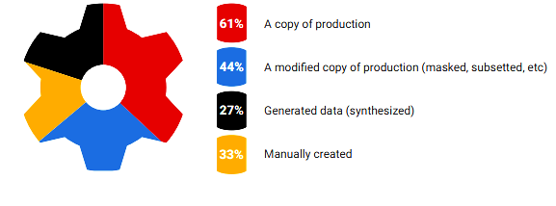
Data is both a blessing and a curse
Where does the data in your development, test or QA environments come from?
Notes:
Now we weren’t just asking you where your data comes from in Pre-Production because we were interested, but feel it really highlights one of the most obvious vulnerabilities to any DevOps process when we bring the Database into the picture.
We don’t have this same challenge on the application side but of course to ensure we’re adding value and that any changes we make are successful in PROD, we’re driving a shift left mentality to catch bugs sooner. But does this mean that we also have to shift all of our data left as well? Whilst there are a number of reasons you may want that data to be in pre-production, realistically what we probably want is something that looks and feels just LIKE our data, but doesn’t quite have the same level of sensitivity that would ultimately expand our attack surface area by duplicating one of our most precious assets.
So how do we add looking after this data wherever it rests into the DevOps picture?

Slide 12
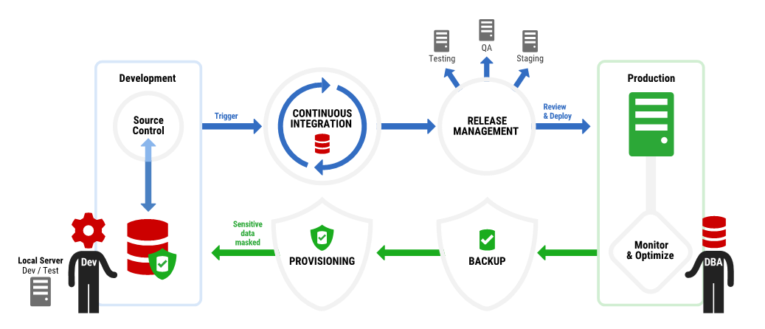
How do we keep data safe by design?
Notes:
CU [talk through diagram – both directions]
Provisioning – Masking & protecting data so that it still works but doesn’t compromise sensitive data
Backing up – ensuring that everything is completely encrypted and protected and keeping up to date retention periods
Monitoring – performance and availability, not losing access to our own data
All of this context for what we have to protect of course comes from a central store, a catalogue of all of our data – if we stay on the cutting edge and easily track any changes happening by using our process, then we’re more easily able to protect data.

Slide 13
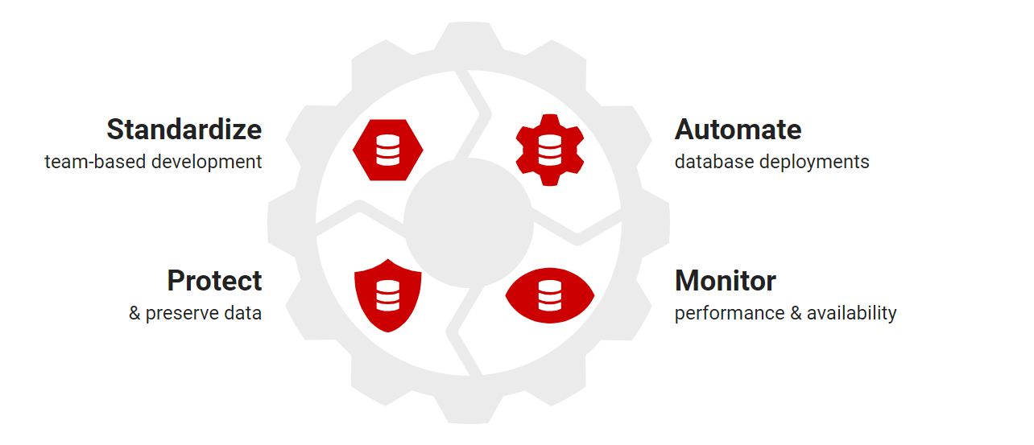
Compliant Database DevOps in action
Notes:
So let’s actually see what this means in practice.
***DEMO: COMPLIANT DEVOPS***
SQL Provision – create masked DBs
SoC, Prompt & SCA – Link to Source Control, make a change, commit and kick off build
Monitor – Performance tuning over the whole process, proactively monitoring data estate and catching unusual activity

Slide 14
Questions?
Notes:
[Moderator Part]
The moderator’s script will be added in this section after deck submission.

Slide 15
Learn more from Chris
@RedG_Chris
Chris.unwin@red-gate.com
Notes:
[Moderator Part]
The moderator’s script will be added in this section after deck submission.

